Slide 1
Guarding against deception: Building Phishing Awareness HR & Marketing Department

Slide 2
What is phishing?
Phishing is a type of cyber attack where scammers impersonate trustworthy entities to trick individuals into revealing sensitive information or clicking on malicious links, often resulting in identity theft or financial loss.

Slide 3
Learn to spot phishing emails
Check sender's email address: Verify the sender's email domain for authenticity and watch out for misspellings or inconsistencies.
Hover over links: Hover over links before clicking to reveal the actual URL; if it looks suspicious or doesn't match the sender, avoid clicking.
Look for generic greetings or urgent requests: Be wary of emails addressing you as "Dear Customer" or creating a sense of urgency, such as demanding immediate action.
Check for spelling and grammar errors: Phishing emails often contain noticeable mistakes in spelling, grammar, or awkward language usage, which legitimate organizations typically avoid.

Slide 4
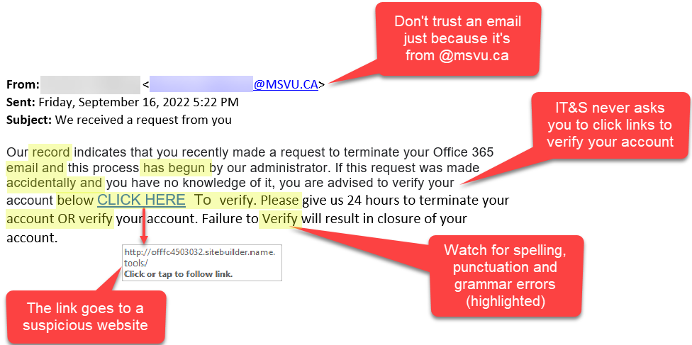
Example:

Slide 5
How do we stop getting phished?
Awareness: Be alert and recognize phishing signs.
Verification Practices: Double-check sender addresses and URLs.
Security Measures: Use email filters and enable 2FA.
Reporting Procedures: Establish clear protocols for reporting suspicious emails.

